Slide 1
Targeting Beyond Opted-In Customers
Prism Week 2 Project by Red Team

Slide 2
Executive Summary
Situation
Complication
Solution
Prism has 368,000 users, but only 27,000 are opted-in for marketing emails, contributing 11% of total revenue.
Focusing only on opted-in users overlooks opportunities, as registered but not opted-in users contribute 56% of revenue and unregistered users 32%.
Targeting opted-in and non-opted-in users with personalised campaigns, optimising marketing spend, and leveraging data-driven insights will drive revenue growth and long-term profitability.

Slide 3
Definition of Segmentation
RFM Definition
RFM segmentation
Persona Grouping
Recency
How recent a customer has purchased
Frequency
How many transactions a customer has had
Monetary Value
How much money a customer has spent
Assigned each customer a number from 1 to 3 based on definitions.
Then merged these numbers to create 27 further segmentations
Group the segments into 6 personas
Champion
Loyal
Recent
High Potential
Needs Nurturing
Loyal
Notes:
RFM Segmentation Approach: Our segmentation was based on both statistical discovery and industry standards.
Recency:
Last 6 months
6 months to 2 years
2+ years
Frequency:
5+ transactions
2-4 transactions
1 transaction
Monetary Value:
£50+
£25-£50
< £25
Personas:
Champions: Top customers, frequent and high spenders.
Loyal: Less frequent but valuable
Recent: Recent buyers with potential for frequent engagement
High Potential: Close to making large purchases
Needs Nurturing: Engaged but not fully.
Inactive: Unengaged for a long time.

Slide 4
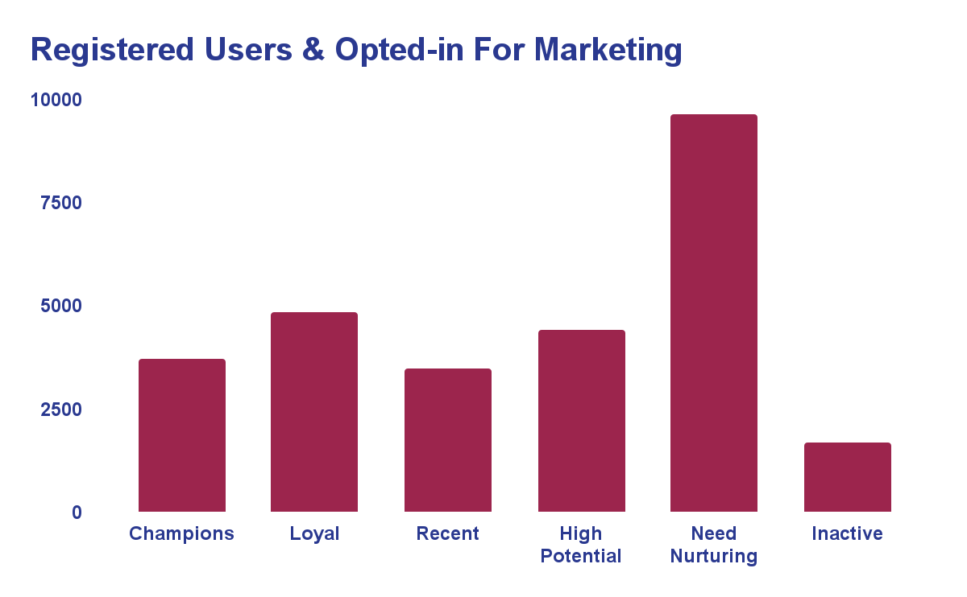
Not Enough Users Signed Up For Marketing
Discovered that there are 27,000 registered users opted-in to receive marketing
These users contributed £1.3m in revenue
Notes:
Out of the 368K distinct registered and unregistered users, we only have 27k who are registered and signed up for marketing
These users contributed almost 11% in overall revenue
We thought that this number was too small
We decided to do further analysis on other user groups and personas

Slide 5
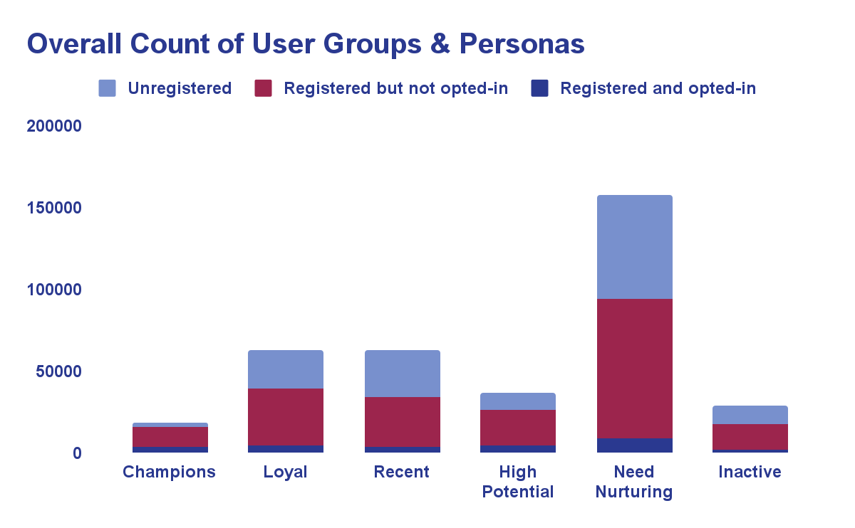
Targeted Users Make Up Low Amount of Overall
Current target users only make up 7% of our overall user base
Notes:
By taking a wider view of our user groups
It’s apparent that our target users of 27k
Compared the 195k of those who are registered and not opted-in
And 136k who are unregistered
Has led us to reconsider our approach

Slide 6
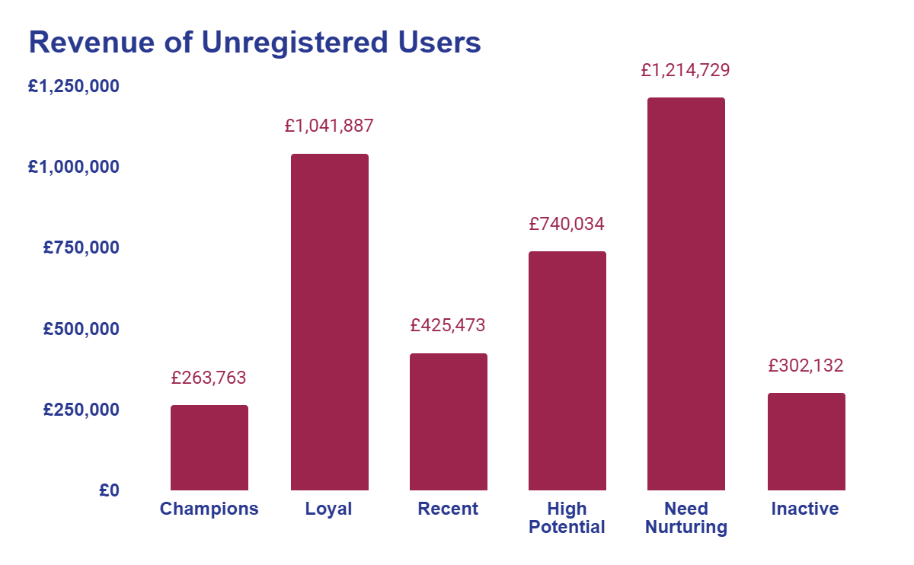
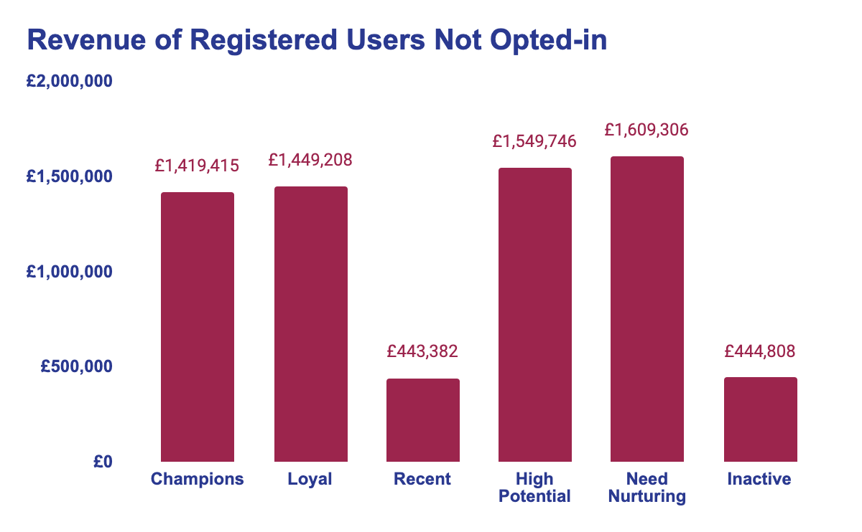
Registered Users Who Are Not Opted-in & Unregistered Users,
Were Almost Missed Opportunities
Registered users who are not opted-in contributed 56.15% and unregistered contributed 32.38% in overall revenue
Notes:
By analysing more into how much the registered and not opted-in and unregistered users contributed to overall revenue
We found that registered users who are not opted-in contribute to 56% of revenue and unregistered at 32%
This is much larger in comparison to our target users who are only contributing 7%
So by considering other user groups and taking a step back
We’ve identified larger opportunities that would’ve been unleveraged if we had only focused on our target users
Potentially only a small impact

Slide 7
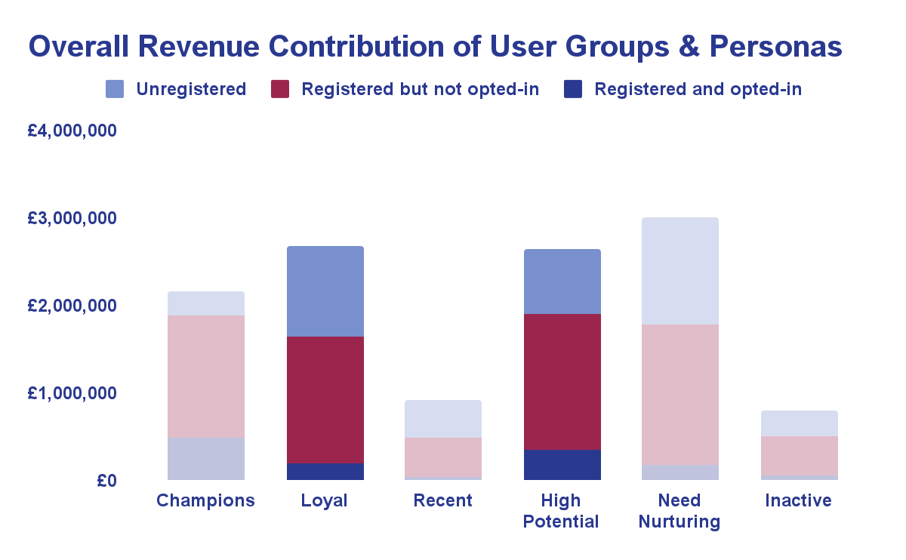
Loyal & High Potential Need to Become Champions
Both personas in registered user groups who are opted-in and not opted-in combined, contribute a total of 28.89% in total revenue
Notes:
Our analysis shows that targeting Loyal and High Potential registered users
both opted-in and not opted-in, offers the highest return potential for marketing and retargeting campaigns.
These groups contribute nearly 29% of overall revenue.
Loyal users consistently purchase and trust Prism,
while High Potential users show strong frequency or spending but remain under-engaged.
Together, these personas represent our best revenue opportunities and are likely to respond well to personalised campaigns.

Slide 8
Strategies
 | Loyal | High Potential
Opted-in | Loyalty-focused email campaigns, early access to sales and product exclusives | Personalised email campaigns
Not opted-in | Retargeting using social media ads On-site promotions | Retargeting using social media ads, discounts, personalised product recommendations On-site promotions
Notes:
For registered and opted-in users:
We recommend launching loyalty-focused email campaigns with exclusive offers,
early access to sales, and product exclusives.
The risk is low, as these customers are already engaged and likely to respond well to tailored rewards.
For registered but not opted-in users:
Retargeting ads and on-site promotions will highlight exclusive offers and loyalty rewards.
Personalisation based on past behaviour reduces risk, though there’s a moderate chance of ad fatigue.
Throughout the campaign, A/B testing will be conducted to optimise both email and retargeting strategies, refining them over time to maximise conversion rates.

Slide 9
Large Returns Based on Small Investment
 | Cost | Conversion Rate Target | Forecasted Return 6 Months | Risk
Loyal (Registered & Opted-in) | Email campaign and content creation: £5,000. | 2.5-3% increase | £10,000 - £12,500 | Low
Loyal (Registered, Not Opted-in) | Retargeting ads: £10,000 On-site notifications: £5,000 | 2.5-3% increase | £27,500 - £36,000 | Moderate
 | Cost | Conversion Rate Target | Forecasted Return 6 Months | Risk
High Potential (Registered & Opted-in) | Email campaign execution and content creation: £5,000. | 2.5-3% increase | £15,000 - £18,000 | Low
High Potential (Registered, Not Opted-in) | Retargeting ads: £15,000. On-site promotions: £5,000. | 2.5-3% increase | £35,000–£42,,000 | Moderate
Prism’s current conversion rate: 0.77%
Notes:
Here is our forecast based on industry benchmarks, bearing in mind Prism’s current conversion rate is 0.77%
Industry benchmarks for email conversion rates in e-commerce: 2-3%
Projected 2.5-3% conversion rate for High Potential or Loyal users aligns with this
Retargeting ads typically achieve engagement rates of 0.7-2%, but personalised campaigns can reach 5-6%
Impact of personalisation:
According to McKinsey: Companies excelling in personalisation generate 40% more revenue
Personalised campaigns and targeting high-value personas (Loyal, High Potential) lead to significantly higher engagement rates and improved marketing results due to increased relevance

Slide 10
Short-Term Incentives Will Equal Long-Term Growth
User Group | 6-month Revenue | Revenue Uplift(%) | Revenue Uplift (£) | Incentive Cost | Net Return
Loyal (Opted-In) | £171,983 | 10% | £17,198 | £17,198 | £0
Loyal (Not Opted-In) | £347,783 | 10% | £34,778 | £34,778 | £0
High Potential (Opted-In) | £290,208 | 15% | £43,531 | £29,021 | £14,510
High Potential (Not Opted-In) | £1,126,923 | 15% | £169,038 | £112,692 | £56,346
 | £1,936,897 |  | £264,545 | £193,689 | £70,856
Prism’s GPM = 45%
Notes:
We’ve analysed the cost and returns of offering 10%-15% incentives to our Loyal and High Potential users.
For example,
Offering a 15% incentive to High Potential (Not Opted-In) users would cost £112K over 6 months.
However, it’s projected to increase their revenue by 15%, adding £169K and yielding a net return of £56K.
Combining this with the £14K net return from the Opted-In group, the total gain is £70K.
This strategy not only drives immediate revenue but also builds long-term customer loyalty.
We mitigate the risk of cannibalisation by focusing on exclusive access rather than across-the-board discounts, preserving profit margins.
Given Prism’s 45% gross profit margin, the benefits of increased engagement and loyalty will outweigh the costs over time.

Slide 11
Let’s Cost Cut
Savings
Optimise Ad Spend through Targeting
£5,000–£6,000
Prioritise High-Converting Channels
£2,000–£4,000.
Leverage In-House Resources
£2,000–£3,000
Automate Email Marketing
£1,000–£2,000
Focus on Opted-In Users (Email Campaigns)
£5,000–£8,000
Optimise Ad Creative for Lower CPC
£2,000–£3,000
Implement a Phased Campaign Approach
£5,000
Total savings: £22,000 - £31,000
Notes:
Based on our forecast, marketing spend are seemingly high, forecasted at £45K, which in turn can put us into a negative, but
If these cost-saving strategies are implemented
We could potentially save between £22K and £31K on the total marketing spend.
This would reduce the overall marketing budget from £45K to a new range of £14K to £23K.

Slide 12
Short-Term Minimal Gains for Long-Term Rewards
Gross Profit Impact
Low-end scenario: £87,500, gross profit = £39,655
High-end scenario: £108,500, gross profit = £49,164
Net impact range: £16,655 to £28,914
Net Impact After Incentives and Marketing Costs
Low-end scenario: £16,655 - £19,405
High-end scenario: £26,164 - £28,914
Stronger brand loyalty
Data-driven insights
Risk mitigation
Long-term value
Scalability
Notes:
Gross Profit Impact:
Low-end revenue: £87.5K with a gross profit of £39K.
High-end revenue: £108.5K with a gross profit of £49K.
Net impact ranges from £16K to almost 29K, indicating strong profitability after costs.
Additional Impacts:
Brand Loyalty: Personalised experiences boost retention and enhance brand perception.
Data Insights: Campaign data will refine future strategies by revealing user preferences and behaviour.
Risk Mitigation: A phased, targeted approach minimises risk and optimises spend based on early results.
Long-Term Value: Exclusive offers increase Customer Lifetime Value (CLV), supporting long-term profitability.
Scalability: Data-driven strategies can be expanded across other segments for improved ROI and efficiency.

Slide 13
Thank you

